Slide 1


Annapurna Online Food Delivery.
Swaad Aapulkicha…!
Guided By-
Sonali Nikam.
Presented By-
Aditya Pawaskar(229004).
Rohan Sakale(229080).

Slide 2

Points to be discussed
Introduction
Motivation
Objective
UML Diagram
Screenshots
Specification
S/W and H/W Requirement
Advantages
Disadvantages
Conclusion
Future Enhancement
References

Slide 3
Introduction
Annapurna food Portal is a web system that provides the function and features to authenticate and identify the customers(users),restaurant managers and delivery persons. Portal provide user with easy, personalized web-interface for facilitating access to restaurant information and food services that are of primary relevance and interests to the users. Annapurna food Portal is nothing but a portal which thinks customers as the main target users and provides so many useful services to customers at a single place. It helps to deliver various cuisine from various restaurant to customers with the help of delivery person.

Slide 4

Motivation
Now a days people wants variety in their meals. Taste cuisine from other parts of their own state as well as food from outside their own state.
Various people where not able to visit the hotel due to their physical disabilities and the rush at the restaurant so to ease their difficulties.
To provide employment opportunity to various unemployed people, to get the employment.
It will help to taste the various famous food verities from various places at a single door . .
To reduce the extra resource consumption like electricity, over utilization of water ,reducing the global warming by providing door to door service with the help of electrical vehicle.

Slide 5
Objectives
The main purpose of this system, is to increase the awareness about various food available in an area . To make cross cultural awareness among the people and to generate the feeling of oneness . Provide on time delivery of foods.
In other words, our food portal has, following objectives:
Simple database is maintained.
Easy operations for the operator of the system. User interfaces are user accommodating and attractive; it takes very less time for the operator to use the system.

Slide 6
Technology Used:
Front End: React
Back End: Java Spring Boot API.

Slide 7
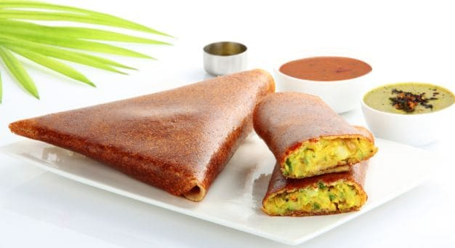
UML Diagrams

Slide 8
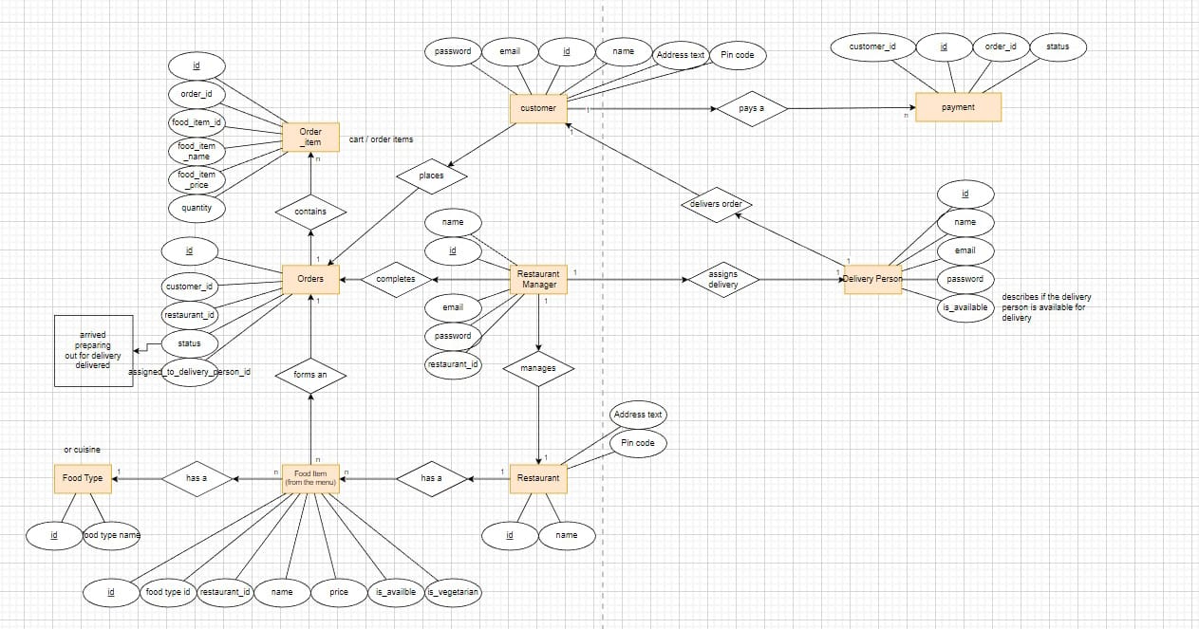
E-R Diagram
ER Diagram
ER Diagram

Slide 9
E-R Diagram(MySQL Auto generated)

Slide 10
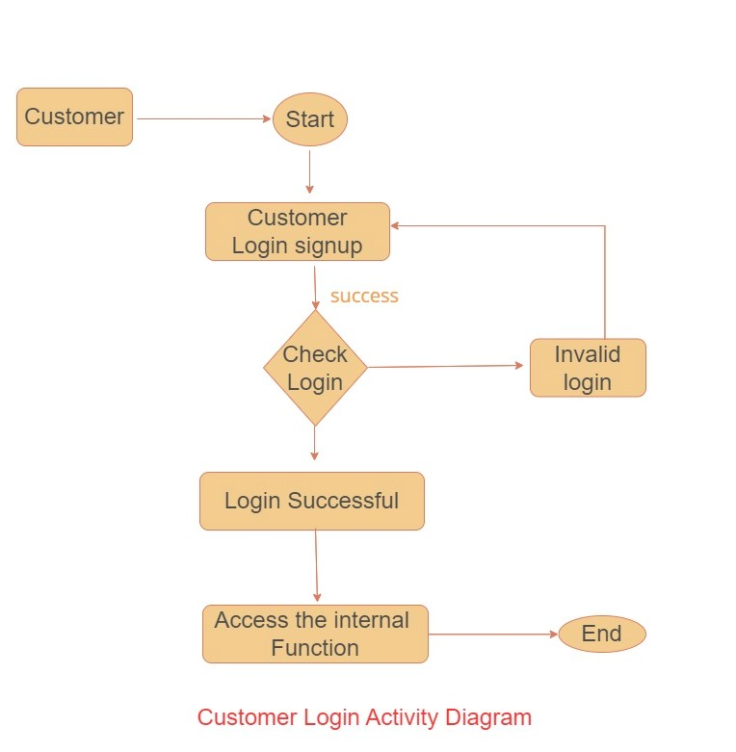

Slide 11
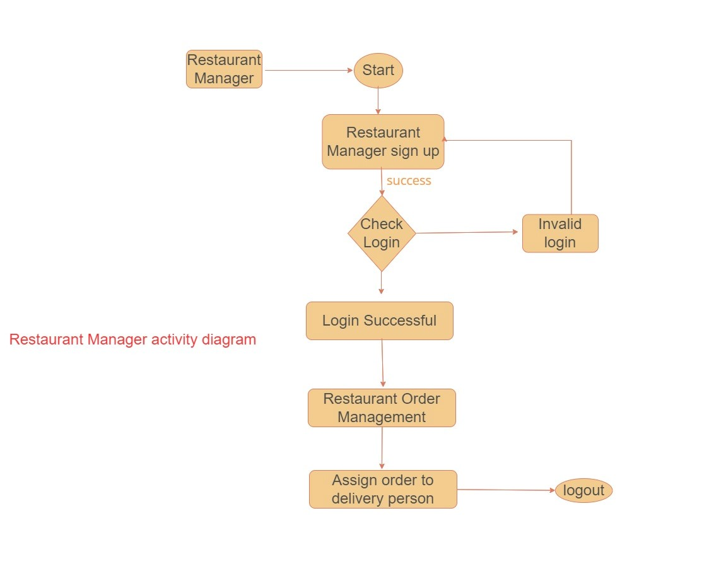
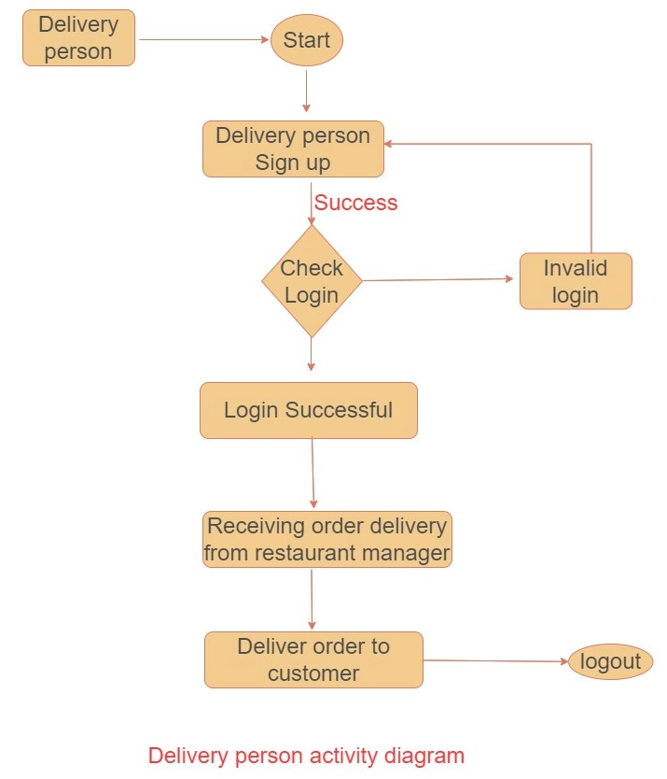
Faculty Activity Diagram

Slide 12
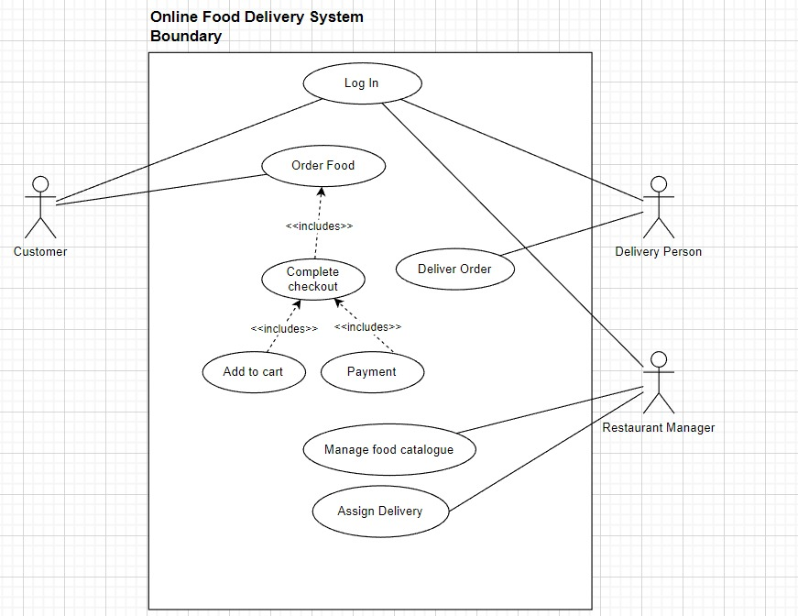

Slide 13
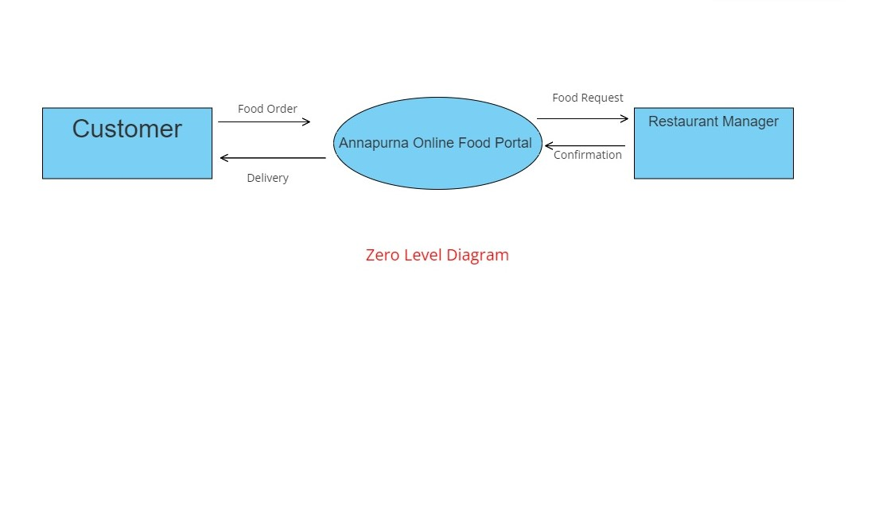
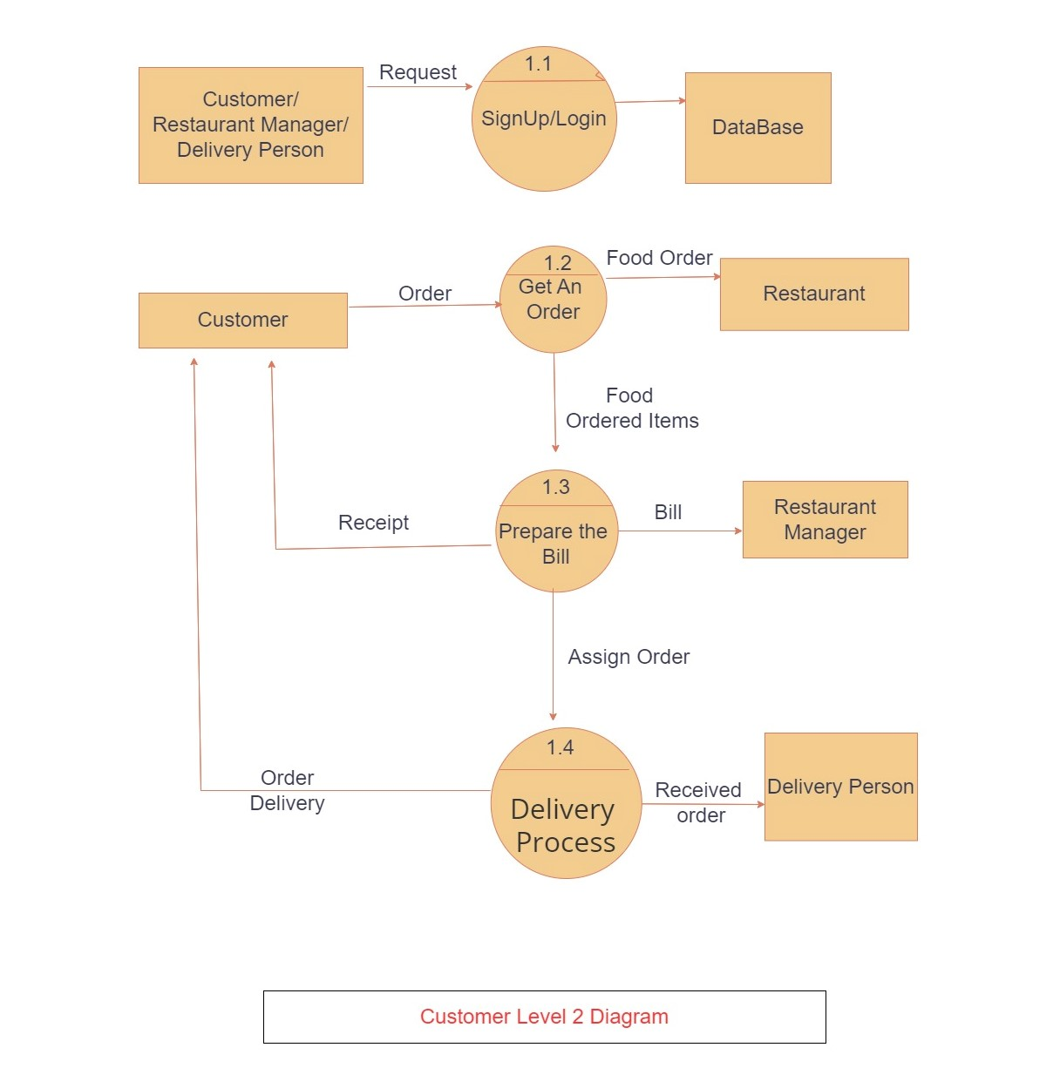
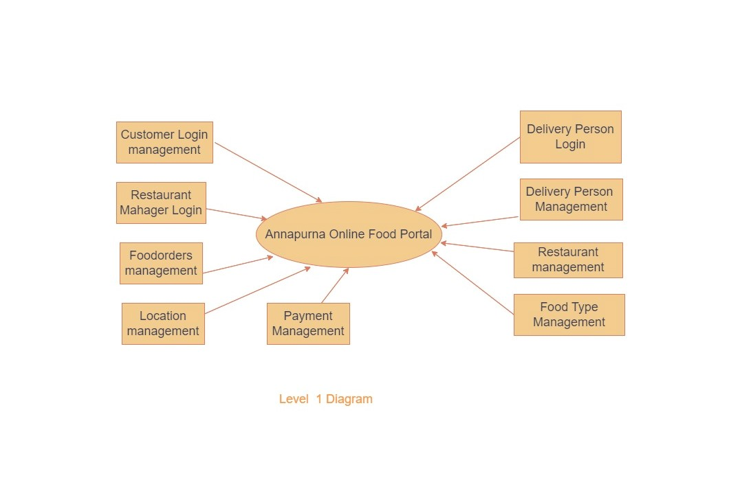

Slide 14
Class Diagram

Slide 15
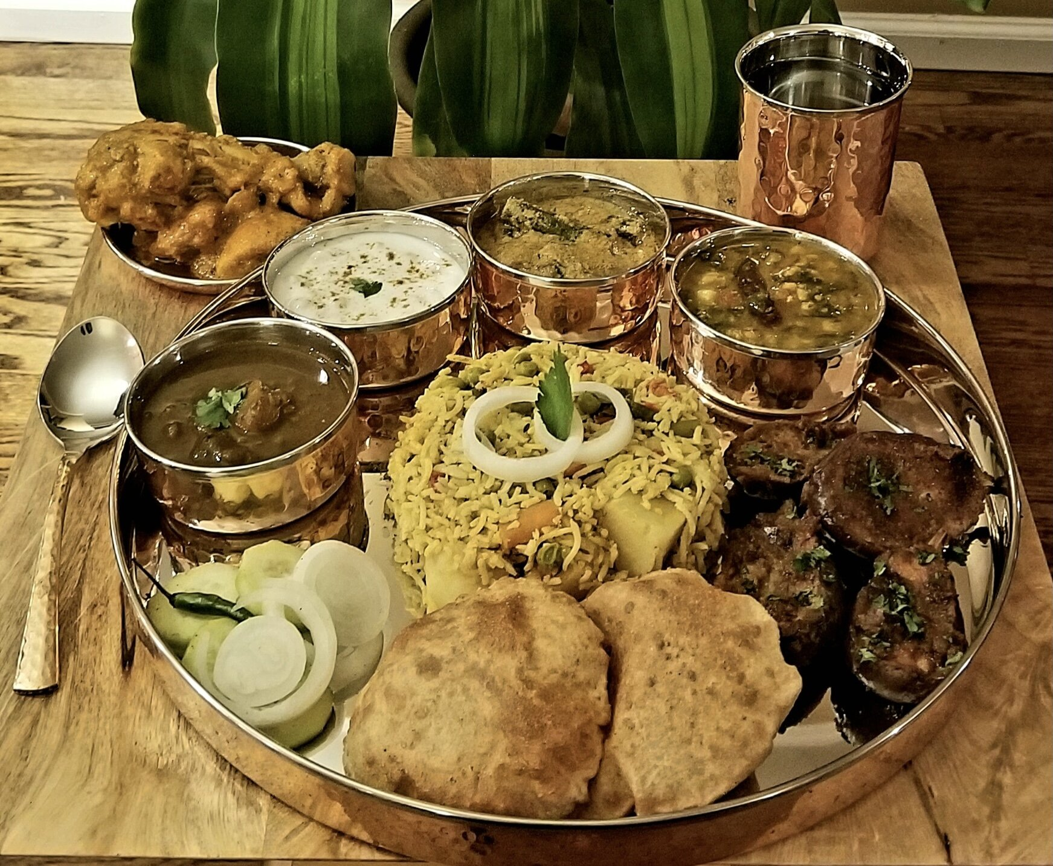
Screen Shots

Slide 19
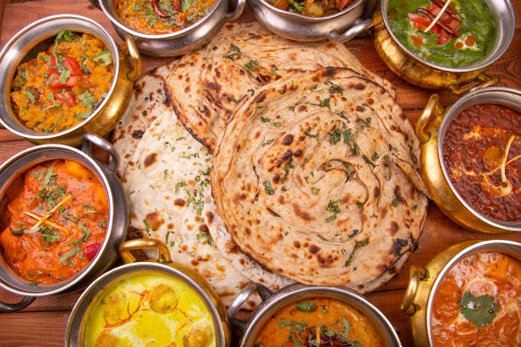
Specification
The application will use JavaScript, java, React as main web technologies.
HTTP and FTP protocols are used as communication protocols.
Mysql database is used for data storing.
SMTP protocol is used for Email communication.
Several types of validations make this web application a secured one and SQL Injections can also be prevented.
Since Annapurna Online Portal is a web-based application, internet connection must be established.
This application helps to connect between the user and various restaurant to deliver the food via online service.

Slide 20
S/W and H/W Requirements
Server Side:
Processor: Intel® Core i5 8th Gen
HDD: Minimum 1TB Disk Space
RAM: Minimum 8GB
OS: Windows 10, Linux 6
Database: MySQL
Client Side (minimum requirement):
Processor: Intel Dual Core
HDD: Minimum 500GB Disk Space
RAM: Minimum 4GB
OS: Windows 10, Linux

Slide 21

Advantages
Manage Customer Orders.
Triangle Coordination between
Customer, restaurant Manager,Delivery person.
Quick delivery of meals
Employment generation.
All requirements at one platform
Cross cultural connection
transformation
Maintained hygine

Slide 22
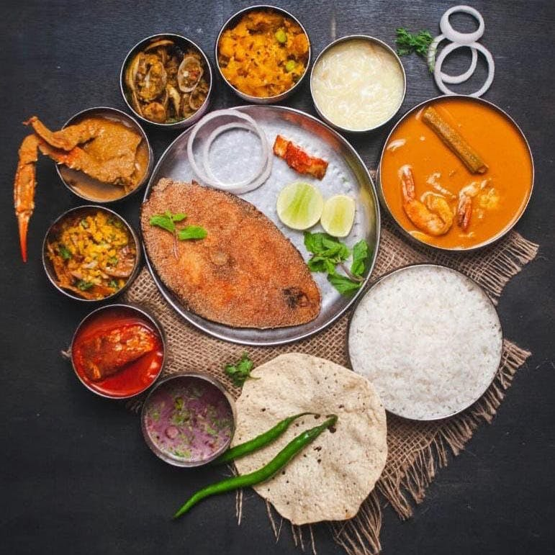
Disadvantages
Delivery may get late due to high requirement of food
Availability of required food may not be available.

Slide 23
Conclusion
Online food delivery system is process of ordering food through single web portal with access to multiple restaurants at the same time
It provide customers an access to various food items from various hotels and helps to try new foods
It provide restaurant manager to increase the business of their hotel.it also provide home delivery of foods with help of delivery person.

Slide 24
Future Enhancement
This project can be enhanced further by adding payable additional hotels, online feedback system, local mess for the members to increase the variety of the foods.
The software is flexible enough to be modified and implemented as per future requirements.
We have tried our Best to present this free and user–friendly website to Institutes.

Slide 25
References
https://www.javatpoint.com/java-mail-api-tutorial
https://www.w3schools.com/
https://react.io/docs
https://javaee.github.io/javaee-spec/javadocs/
https://online.visual-paradigm.com/
https://www.geeksforgeeks.org/

Slide 26

THANK YOU

